Slide 1
Quantum State Tomography
Roohi Verma
Supervisor: Prof. Arvind
Second Year Student
Physics and Math Pre-major, IISER Mohali
1/13

Slide 2

Generation of identical ensemble of states
Step 1:
Due to the stochastic nature of quantum measurements a single pure state won’t help in determining the state that it exists in.
Generate an ensemble of identical states using a source. Since all the individual states are identical it is a pure state and not a mixed state.
The goal is to generate a density matrix $ρ$ at the end of the protocol as the state is unknown. This is done via measurement basis (Pauli X,Y,Z)
2/13

Slide 3
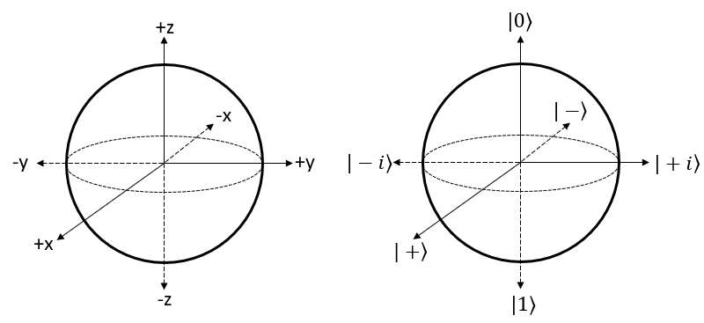
Choosing a measurement basis
Step 2:
Choosing a measurement basis which is tomographically complete.
Measurements can’t be done simultaneously on one state; you measure many copies in each basis separately. For each basis, perform the measurement multiple times to get a sample space of shots.
Measurement in Pauli basis X,Y, and Z:
The measurement is done in Z basis. Hardware cannot directly measure along X and Y basis so a unitary matrix that transforms X(Y) to Z basis and the obtained result can then be mapped back to X(Y) measurements.
To measure X basis: Apply the H gate
Y basis: Apply the S(dagger) gate and H gate.
Z basis: default computational basis.
3/13

Slide 4
Measurement Basis | Eigenstates Associated to the Measurement Basis | Eigenvalues associated to the Measurement Basis | Transformation of the Eigenstates to the Z basis Eigenstates for Hardware Compatibility
X basis | ∣+⟩ | +1 | ∣0⟩ | Applying the H gate on qubits
 | ∣−⟩ | -1 | ∣1⟩
Y basis | ∣i⟩ | +1 | ∣0⟩ | Applying the S† and H on qubits
 | ∣−i⟩ | -1 | ∣1⟩
Z basis | ∣0⟩ | +1 | ∣0⟩ | The computational basis
 | ∣1⟩ | -1 | ∣1⟩
4/13

Slide 5

ESTIMATION OF PROBABILITIES
Step 3:
Estimate the outcome probabilities (empirical probabilities defined by frequency)→ experimentally determined values
$\hat{p}$_{b}(i) =$\frac{n_{b,i}}{N_{b}}$ here b ∈ {X, Y, Z} and i ∈ {0,1}
The true probabilities of the likelihood of getting an eigenvalue for the respective basis:
$$p_{b}\left(0\right)=Tr(ρ{\text{Π}}_{0}^{(b)})$$
For each measurement basis there are two projectors, one for outcome 0 and one for 1.
These probabilities depend on unknown state $ρ$ that we want to find.
5/13

Slide 6


CONSTRAINTS ON A DENSITY MATRIX
Step 4:
Define a density matrix. The density matrix we have to identify must be:
Positive Semidefinite
Hermitian
Trace($ρ$) = 1
$$ρ= \frac{T^{\text{†}}T}{Tr(T^{\text{†}}T)}$$
6/13

Slide 7
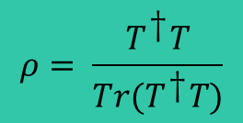
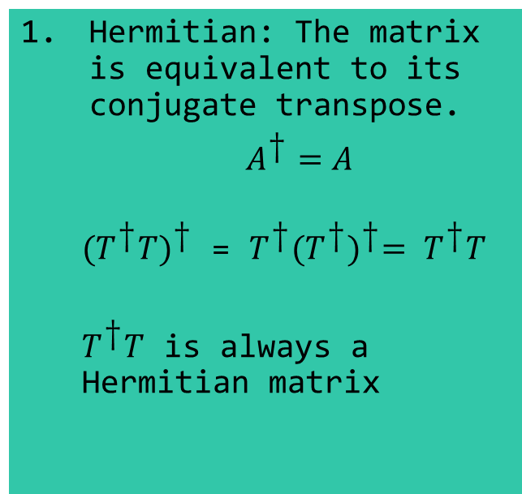
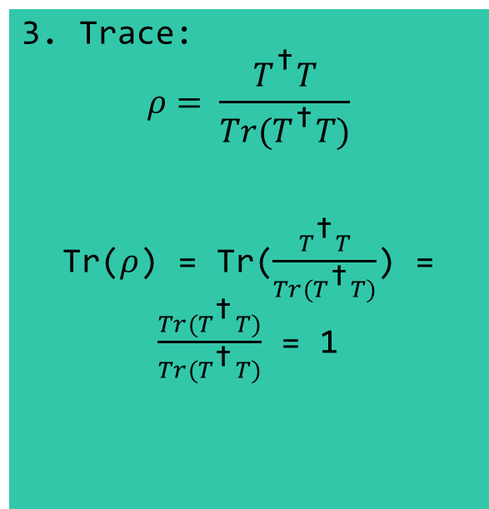
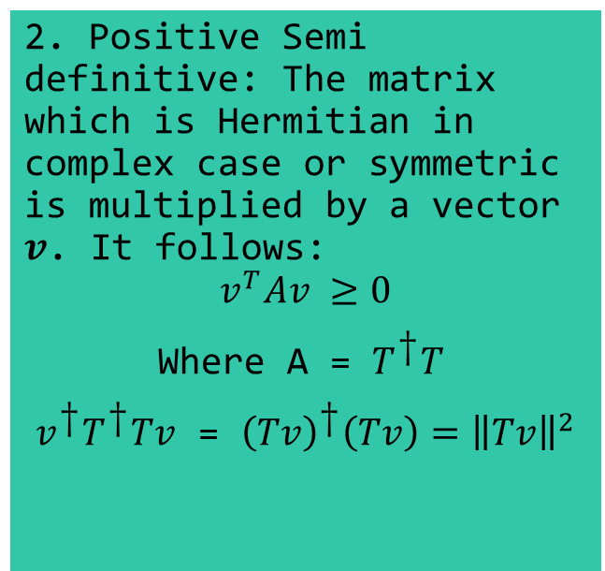
$$ρ= \frac{T^{\text{†}}T}{Tr(T^{\text{†}}T)}$$
Hermitian: The matrix is equivalent to its conjugate transpose.
$A^{\text{†}}=A$
${{(T}^{\text{†}}T)}^{\text{†}}$ = $T^{\text{†}}{(T^{\text{†}})}^{\text{†}}= T^{\text{†}}T$
$T^{\text{†}}T$ is always a Hermitian matrix
2. Positive Semi definitive: The matrix which is Hermitian in complex case or symmetric is multiplied by a vector $v$. It follows:
$$v^{T}Av ≥0$$
Where A = $T^{\text{†}}T$
$v^{\text{†}}T^{\text{†}}Tv$ = ${\left(Tv\right)}^{\text{†}}\left(Tv\right)={\left\|Tv\right\|}^{2}$
3. Trace:
$$ρ= \frac{T^{\text{†}}T}{Tr(T^{\text{†}}T)}$$
Tr($ρ$) = Tr($\frac{T^{\text{†}}T}{Tr(T^{\text{†}}T)}$) = $\frac{Tr(T^{\text{†}}T)}{Tr(T^{\text{†}}T)}$ = 1
7/13

Slide 8

ASSUMING PARAMETERS ON A DENSITY MATRIX
The Cholesky Decomposition generates a lower triangular matrix whose product with it’s transpose conjugate gives a matrix A such that A is Hermitian and Semidefinite.
So, A= $T^{\text{†}}T$ here T is a lower triangular matrix
T = $\left(\begin{matrix}t_{1} & 0 \\ t_{3}+it_{4} & t_{2}\end{matrix}\right)$
$$p_{b}\left(0\right)=Tr(ρ{\text{Π}}_{0}^{(b)})$$
Where $ρ$ is a function of the parameters t₁ ,t₂ ,t₃, and t₄.
8/13

Slide 9

Maximum Likelihood Estimation
It is a statistical method to check the consistency of assumed parameters with the observed data.
A likelihood function is generated. It measures the support provided by the data for each possible value of the parameter.
$$L\left(t\right)=P\left(Data | t\right)$$
9/13

Slide 10


Likelihood Function for Our Case…
$$L\left(t\right)=P\left(x_{1}{,x}_{2}{,x}_{3},x_{4}{,x}_{5},…|t\right)$$
These are independent events so can be written as:
$L\left(t\right)=P\left(x_{1}|t\right)$ $P\left(x_{2}|t\right)P\left(x_{3}|t\right)$… $P\left(x_{n}|t\right)$
In our case:
$L\left(t\right)={{[p}_{X}(0)]}^{n_{X,0}}$ ${{[p}_{Y}(0)]}^{n_{Y,0}}{{[p}_{Z}(0)]}^{n_{Z,0}}$ ${{[p}_{X}(1)]}^{n_{X,0}}$ ${{[p}_{Y}(1)]}^{n_{Y,0}}{{[p}_{Z}(1)]}^{n_{Z,0}}$
$$L\left(t\right)=\prod_{b =X,Y,Z}{\prod_{i=0,1}{{{[p}_{b}(i)]}^{n_{b,i}}}}$$
Here we know that ${\text{p}}_{\text{b}}\text{=}\text{Tr}\left(\text{ρ}\left(\text{t}\right){\text{Π}}_{b}^{i}\right)$ so,
$$L\left(t\right)=\prod_{b =X,Y,Z}{\prod_{i=0,1}{{\text{[}\text{Tr}\left(\text{ρ}\left(\text{t}\right){\text{Π}}_{b}^{i}\right)]}^{n_{b,i}}}}$$
To maximise this, we differentiate. To simplify the problem we can take a log-likelihood of the function. This is a non-linear optimization problem which can now be solved using Numerical Packages like Scipy and guess the correct value of t’s using iteration.
$$\ln{L\left(t\right)= \sum_{b=X,Y,Z}{\sum_{i=0,1}{n_{b,i}\ln{(\text{Tr}\left(\text{ρ}\left(\text{t}\right){\text{Π}}_{b}^{i}\right)})}}}$$
$$t_{MLE}=\arg{max⁡(log⁡(L(t)))}$$
$t$
10/13

Slide 11
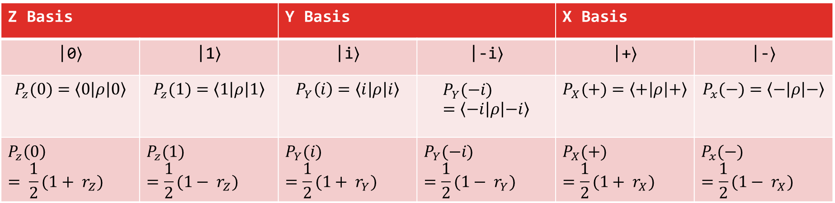

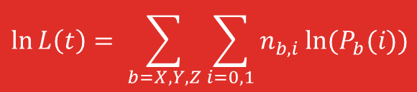
A MANUAL MATHEMATICAL APPROACH
Reconstruction through a bloch sphere representation:
$$ρ\left(r_{x},r_{y},r_{z}\right)=\frac{1}{2} (I+ r_{x}X + r_{y}Y + r_{z }Z)$$
On calculating probabilities:
$$\ln{L\left(t\right)= \sum_{b=X,Y,Z}{\sum_{i=0,1}{n_{b,i}\ln{(P_{b}(i)})}}}$$
Z Basis |  | Y Basis |  | X Basis
|0⟩ | |1⟩ | |i⟩ | |-i⟩ | |+⟩ | |-⟩
$$P_{z}(0)=\left\langle 0 | ρ | 0\right\rangle$$ | $$P_{z}(1)=\left\langle 1 | ρ | 1\right\rangle$$ | $$P_{Y}\left(i\right)=\left\langle i | ρ | i\right\rangle$$ | $$P_{Y}(−i)=\left\langle −i | ρ | −i\right\rangle$$ | $$P_{X}(+)=\left\langle + | ρ | +\right\rangle$$ | $$P_{x}(−)=\left\langle − | ρ | −\right\rangle$$
$$P_{z}\left(0\right)= \frac{1}{2}(1+ r_{Z})$$ | $$P_{z}(1)=\frac{1}{2}(1− r_{Z})$$ | $$P_{Y}(i)=\frac{1}{2}(1+ r_{Y})$$ | $$P_{Y}(−i)=\frac{1}{2}(1− r_{Y})$$ | $$P_{X}(+)=\frac{1}{2}(1+ r_{X})$$ | $$P_{x}(−)=\frac{1}{2}(1− r_{X})$$
The partial differentiation w.r.t r_{x}, r_{y}, r_{z} and a physical constraint of $r_{X}^{2}+r_{Y}^{2}+r_{Z}^{2}≤1$
11/13

Slide 12
Advantage of MLE over bloch representation
MLE ensures a physical state which is Hermitian, Positive semidefinite, and normalized. Bloch vector representation parameterization doesn’t take into account all the constraints and may return an unphysical matrix
MLE can be extended for multi-qubit states and entangled states. The same is not possible for Bloch representation
MLE also handles noisy and finite data better.
12/13

Slide 13
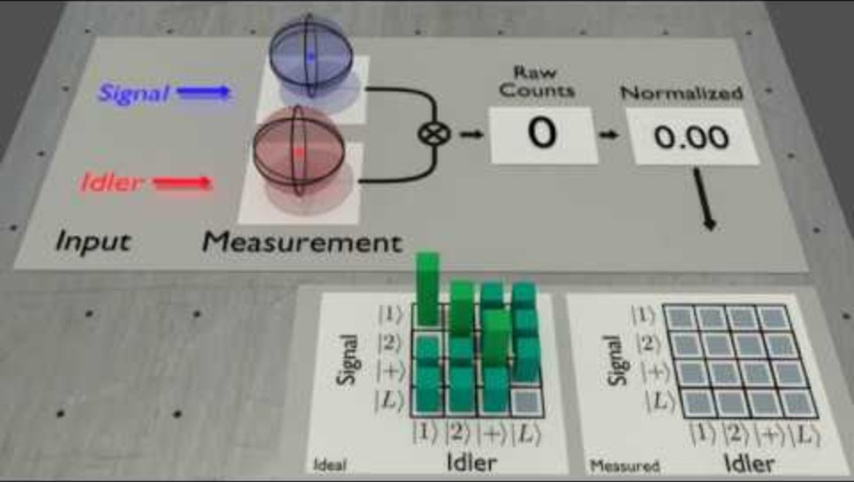
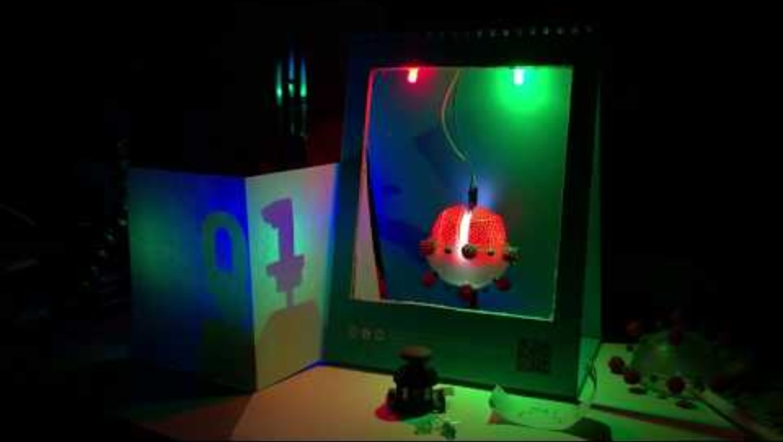
Visual Representations

